Slide 1
Harmony SEL-Academic Integration Academy
Session 3: Balanced Instruction

Slide 2
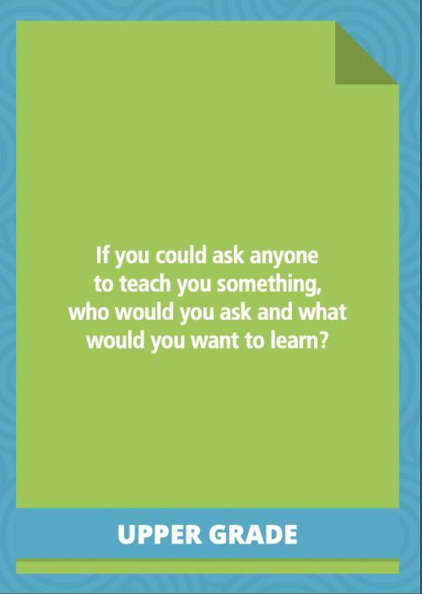
Greetings
Presenters:
Nick Yoder, PhD & Jako Tjoutuku
Share in chat…
Name
School
Title
Response to Quick Connection Card
Notes:
00:00-00:05 **(provide notetaking guide)**
Facilitator directions
-Adjust the settings so that saving the chat is available for everyone
-Record the session
-Provide the notetaking guide
-Make sure to have two polls prepared of the same thing
- Explicit skill alignment
- Explicit strategy alignment
- Way of Interacting
- Way of Being
-Open videos
Balanced Instruction: https://www.youtube.com/watch?v=1qxVfhGHUC0
SAY: Thank you for having me back to continue our work on academic integration.
As a reminder, I am __________________ and I am [role]. [state why you like academic integration so much]
There is a prompt on the screen for you to respond to one of the Quick Connection Cards from Harmony SEL. Please share in the chat your name, school, title, and a response to the Quick Connection Card.
Now before we get started, I wanted to provide you with the notetaking guide. We will reference this guide throughout the professional learning.

Slide 3
Agenda
Welcome and Objectives
Setting the Stage
Practice 2: Balanced Instruction
Connecting Balanced Instruction with Harmony
Action Planning
Next Steps
Notes:
00:05 - 00:07
Thank you for continuing your journey as Harmony SEL leaders. We know that your job is demanding and requiring you to use new skills and strategies, and activate the necessity of self-care as you navigate the stressors of your job. We are hoping that this is a space to help navigate problems of practice, specifically thinking of how to both accelerate student learning, attend to student emotional and social well-being, and build relationships.
Here is a look at our agenda today to help continue on this journey. We will first recap last session. We will then focus on one educator practices, Balanced Instruction. For the practice, we will:
Describe what it is
Define specific strategies to implement the practices
Watch an educator implement the practice
Review a Harmony activity that facilitates student engagement
Identify an example taxonomy and
We will wrap up with action plan using formative lesson plan template.

Slide 4
Objectives and Outcomes
Notetaking guide: page 1
Identify strategies to apply Balanced Instruction practices
Inspire students to engage in individual and collaborative Harmony SEL skills with peers and adults
Explore and define SEL-academic integration taxonomy examples using Harmony SEL skills
Elevate student assets within classrooms, creating rigorous and supportive environments
Determine how Harmony SEL aligns with integrative practices
Amplify skills developed through Harmony into the instructional day
Apply lessons learned into your own planning and interactions with students
Execute strategies that enhance whole child development.
Notes:
00:07 - 00:09
Recognizing the incredible strain, stress, and lift that has been placed on educators and their students, we hope this learning experience provides you an opportunity to create space for yourself to learn, build your capacity to support your students, and be more intentional and focused with how you support student SEL.
Here are our objectives we will reach today and the ultimate outcomes we hope to see for our students and learning environment.
Identify how the teaching practice –Balanced Instruction –that will inspire students to engage in individual and collaborative instruction, using Harmony SEL skills with peers and adults
Explore and define the SEL-academic integration taxonomy examples, using Harmony SEL skills. When you implement an integrative approach you elevate student assets within classrooms, where students can better access the curriculum.
Determine the ways in which Harmony SEL promote skills needed in integrative practices, amplifying the skills students learn in Harmony throughout the curriculum.
Begin to plan on how you will be more intentional in your SEL support, amplifying student learning and recognizing that whole child development requires educators to attune to the link between student social, emotional and academic development.
As you reflect on these objectives, take 20 seconds and set your intention for the session. What are you hoping to really gain from this sessions? Jot it down in the notetaking guide.

Slide 5
Community Agreements
In every chair a learner; in every chair a leader
Speak to be understood; listen to understand
Return to being present; work to stay engaged
Take care of yourself; take care of each other
Maintain safe space for meaningful conversations
Expect and embrace experiences of non-closure
Notetaking guide: page 1
Notes:
00:09 - 00:11
Say: Please review the current community agreements, they are the same as last week [or have someone else read] (pause for 30 seconds)
Say: Would anyone like to update the community agreements (Pause 15 seconds)
Say: Now identify one community agreement you really want to focus on today. Jot it down in the notetaking guide.

Slide 6
Setting the Stage
Notes:
First let’s recap what we learned last time on SEL-academic integration

Slide 7
Implementing SEL
Three integrated classroom-based approaches
Target specific social and emotional competencies during specified instructional time
Implement general pedagogical practices that develop safe and supportive schools and classrooms
Explicit Skill Instruction: Harmony SEL
General Pedagogy: 10 Practices
Academic Integration: Taxonomy
Integrate social and emotional competencies with academic content
Sources: Dusenbury et al., 2016;
Notes:
00:18

Slide 8
Ten Educator Practices That Promote SEL
Learning Design and Instruction
Cooperative learning
Group discussions
Self-assessment and self-reflection
Balanced instruction
Expectations and rigor
SEL Competence building
Youth-centered problem-solving
Power of Language
Responsibility and choice
Warmth and support
Affirming Learning Environments
Source: Yoder, 2014
Notes:
00:20

Slide 9
Taxonomy of Academic Integration
Student
SEL Assets
Explicit Skill Alignment
Explicit Strategy Alignment
Ways of Interacting
Ways of Being
Source: Yoder, Ward, & Wolforth, 2021
Notes:
00:21-22
The four ways that SEL shows in the classroom are Explicit Skill Alignment, Explicit Strategy Alignment, Ways of Interacting and Ways of Being. Educators have not received their own taxonomy to help build their own capacity and reduce the burden thinking that SEL is an Add on. The goal of Academic Integration is to seamlessly integrate SEL into all your instructional day and how SEL shows up in various learning environments.
Explicit Skill alignment: Direct link exists between academic standards and the SEL skills. Specific SEL skills are found within academic standards.
Explicit Strategy Alignment: Direct link exists between practices required to engage in the content and the SEL skills required to engage in the content practice.
Ways of Interacting: SEL skills mediate success in academics. Students use SEL skills to interact with content and with others to master academic skills.
Ways of Being: Based on the content domain, individuals use SEL skills in specific ways. Individuals across content will use similar SEL skills, but how they use the skills vary.
One thing we learned last time is often there is a lot of overlap between this taxonomy and it is based on how we want to frame the SEL students are learning and we are reinforcing.

Slide 10
Breakout Room
Activity 1: Integration Reflection
How have you supported your educators in integrating SEL work throughout the school day based on the learning (through Warmth & Support)?
Notetaking guide: page 1

Slide 11
Balanced Instruction
Sources: Aspy, Roebuck & Aspy, 2014; Darling-Hammond et al., 2019
Notes:
00:26
As defined here, balanced instruction includes student participation in multiple instructional strategies that are based on their needs, interests, and background so they can maximally engage with content and apply their social and emotional competencies.
Balanced instruction encourages a deep conceptual understanding of content through a combination of problem-based tasks with explicit instruction needed to accomplish those tasks (Darling-Hammond et al., 2019).
In other words, the goal of balanced instruction is to create a mix of direct, explicit, and active instruction focused on authentic learning experiences that involve individual and collaborative work, social interactions, and appropriate integration of technology (Aspy et al., 2014).

Slide 12
Exploring Balanced Instruction
During Balanced Instruction, students…
Engage with content in multiple ways.
Receive instruction that acknowledges and attunes to student affect.
Feel challenged to reach their potential.
Use their social and emotional competencies.
Sources: Aspy, Roebuck, & Aspy, 2014; Pianta, Hamre, & Mintz, 2012
Notes:
00:27
Through balanced instruction, educators help students develop and extend the capacity to connect with others to create a sense of belonging, engage thoughtfully with content, and develop agency over their own learning by increasing responsibility to students, which is particularly important at a time in our history when we are increasingly immersed in online or virtual exchanges. Specifically, students
Engage with the content in multiple ways, including games, play, projects, and other mechanisms, They further examine content critically, pose thoughtful questions, consider varying perspectives, and work individually and cooperatively to develop a deep understanding of subject matter.
Receive instruction that attends to the research that students do better when teachers pay attention to student emotions and affect. The teacher provides emotional support for active participation and risk taking, exploration, inquiry, and choice, and rigorous and differentiated learning opportunities that
Feel appropriately challenged individually and through social interactions.
Use their social and emotional competencies to guide their learning

Slide 13
Exploring Balanced Instruction
Benefits of Balanced Instruction
Collaborate and cooperate with their peers
Connect their lived experiences to their learning experiences
Make evidence-informed decisions
Understand the influence of their actions
Sources: Condliffe, Quint, Visher, Bangser, Drohojowska, Sacro, & Nelson, 2017; Darling-Hammond et al., 2019
Notes:
00:28
Students obtain multiple benefits when they engage in balanced instruction, including
Work with their peers as they refine their critical thinking skills through listening carefully and thoughtfully, examining and observing content closely and critically, communicating clearly and sensitively, and engaging respectfully;
Acquire knowledge and new understanding connected to student background knowledge and lived experiences through displaying intellectual curiosity and open-mindedness and suspending presumptions as they attend to perspectives different from their own;
Make evidence-informed decisions, connect new understanding with the expectation for responsible action, and think deeply and consider how their actions and decisions will affect others, becoming more self-directed in their learning; and
Plan, monitor, and reflect on the progression of their actions and their impact on events, circumstances, and others.

Slide 14
Exploring Balanced Instruction
General Principles of Balanced Instruction
Promote conceptual understanding
Provide consistent positive emotional support
Incorporate meaningful participation
Include rigorous learning opportunities
Use differentiated opportunities
Extend student thinking
Integrate problem solving and deep analysis
Provide guided opportunities
Use language
Incorporates performance assessments
Respond in the chat with which principle aligns best to your teaching practice!
Source: Condliffe et al., 2017; Darling-Hammond et al., 2019; Diamond, & Hopson, 1999; Johnston, 2004
Determine: Student Directed vs Teacher Directed
Define: Goals, Processes, Expectations
Design: Direct Instruction vs PBL
Decide: Maximizing time & resources
Notes:
00:29-00:34/
General principles exist for Balanced Instruction. Which of these principles do you observe most in your walkthroughs or collaborative planning times? What areas of growth do you see for your educators with these principles. Please feel free to unmute or put answer in chat.
Optional Text. General Principles of Balanced Instruction
Balanced instruction supports a thoughtfully designed curriculum that addresses the multidimensional social, emotional, and academic needs and experiences of learners in an enriched environment in a way that ensures a well-rounded education through culturally-responsive sustaining practices. Multiple approaches exist to implement balanced instruction. General principles that cut across the approaches include the following (Condliffe et al., 2017; Darling-Hammond et al., 2019; Diamond, & Hopson, 1999; Johnston, 2004).
Promote conceptual understanding through the design of problem-oriented tasks that integrate direct instruction on key ideas, organized within a conceptual framework, and inquiry opportunities. Projects or problem-oriented tasks may be centered on a driving question and they target significant learning goals.
Provide consistent positive emotional support for active participation and risk taking rather than passive observation;
Incorporate meaningful participation, exploration, inquiry, and choice across mental, physical, aesthetic, social, and emotional competencies, providing sufficient time for students to sufficiently engage.
Include rigorous learning opportunities that appropriately challenge students individually and through social interactions that build upon and expand student prior knowledge and experiences and scaffolds learning from their current understanding;
Use differentiated opportunities that address all learning needs and unleash the potential in all students, ensuring multiple solutions can be reached within the problem;
Extend student thinking through helping them draw comparisons, determining what something “is like” or thinking through hypotheticals of potential responses to actions, asking students “what if” or helping them think through “if—then” statements.
Integrate problem solving and deep analysis of inequitable systems and multiple perspectives of histories;
Provide guided opportunities for students to learn goal setting, self-monitoring, self-assessment, and self-correction, core components of executive functioning;
Use language to help students transfer the knowledge and skills they are learning, starting with “what do you know” and then helping students reflect the way of work in the content domains, “what do scientists or authors do”; and
Incorporate performance assessments that allow students to showcase high order thinking, and metacognitive and co-cognitive skills, including strategies for students to self-assess.
Through these principles, balanced instruction involves the delicate integration of direct, explicit instruction with highly interactive individual and collaborative project-based learning; engages learners metacognitively as they plan, monitor, and evaluate their individual and collective actions; and prepares them to connect sensitively with material and with those in the world around them to make evidence-based decisions for responsible action.

Slide 15
Exploring Balanced Instruction
Balanced Instruction Practices
Direct, Explicit Instruction
Active Instruction
Project-based Learning
Competency Based Education
Whole Child Development
Source: Darling-Hammond et al.,2019; Luke, 2014; Sur & Redding, 2017
Notes:
00:035 - 00:36
Balanced Instruction Practices
The goal of balanced instruction is not only to create fun activities, but also to create those activities and use those instructional techniques that engage students in the most meaningful learning experience to master content.
A number of instructional approaches, which include but are not limited to
Direct instruction, is a form of explicit instruction and helps prepare students and educators alike to more fully engage in project-based and inquiry-focused instruction
Project-based learning is an instructional approach in which students explore authentic learning tasks of personal interest to them
Competency-based learning is geared to improving student opportunities for learning by placing emphasis on identifying and measuring specific learning outcomes; and helping students apply learning to real world problems.
You can also implement other practices within this series of 10 educator practice modules to implement balanced instruction, such as power of language, cooperative learning, and group discussions.

Slide 16
Core Components of Direct Instruction
Direct Instruction Involves…
Educator-directed interaction guided by clear behavioral goals and outcomes;
Educators’ adherence to structured, packaged instructional materials;
Educator modeling, guided student practice with feedback, and independent student practice; and
The gradual transfer of responsibility from educator to student.
Source: Marchand-Martella, Slocum, & Martella, 2004; Rosenshine, 2008
Notes:
00:037
DI helps prepare students and educators alike to more fully engage in project-based and inquiry-focused instruction, as it guides students towards learning. DI includes multiple components, including (Marchand-Martella, Slocum, & Martella, 2004; Rosenshine, 2008):
Educator-directed interaction guided by clear behavioral goals and outcomes;
Educators’ implementation of highly structured, packaged programmed instructional materials;
Educator modeling, guided student practice with feedback, and independent student practice; and
The gradual transfer of responsibility from educator to student, with a primary goal of student mastery.
Despite its endurance across time, many believe that direct instruction is incongruent with a constructivist approach or that it may overlook student cultural resources or student backgrounds. However, direct instruction is most successful when educators know when to use it and with whom. In other words, when it provides a foundation for student learning and building student background knowledge, which can be helpful when used with more active approaches to learning.

Slide 17
Engaging Students Through Project-Based Learning
Seven Essentials of PBL
Learners need to know
Driving question
Choice and voice
Inquiry & innovation
Feedback and revision
SEL skills
Public presentation of a product
Source: Darling-Hammond et al., 2019; Larmer & Mergendoller, 2010; Schwarlm & Tyleck, 2012
Notes:
00:038 - 00:39
Unlike direct instruction, which is based on a educator’s dissemination of established facts, project-based learning calls for learners to explore conditions, circumstances, and possibilities. It honors students as learners to create questions and identify evidence to answer them. PBL provides learners with a chance to connect their curiosities and interests to formal learning tasks.
Although multiple frameworks for project-based learning exists, Larmer and Mergendoller (2010) state that there are seven essentials when educators implement PBL: defining what the learners’ need to know, a driving question, the learner’s choice and voice, inquiry and innovation, feedback and revision, presentation of a product to an audience, and 21st century skills or social and emotional competencies. Through each of these essential elements, students co-construct knowledge with their peers and develop agency of their own learning and learning outcomes (Darling-Hammond et al., 2019). Further, to promote effective project-based learning, students need access to high-quality resources and supports to gather information, test ideas, and obtain feedback from peers, adults and experts.
Project-based learning provides an avenue for all learners from diverse backgrounds to engage in activities that develop core skills and knowledge and engage in high-order thinking skills (Schwalm & Tyleck, 2012). When educators use PBL strategies that authentically engage student interests, cultures, and lived experiences, all students will feel motivated to learn. Oftentimes there is a concern about too much cognitive load for students. However, when PBL engages student’s curiosity and interests, and when educators provide the necessary scaffolds to develop conceptual understanding of the ideas within healing-centered environments, students’ abilities to process information increases (Darling-Hammond et al., 2019).
Refer to the other modules like warmth and support, self-assessment and self-reflection, cooperative learning, and competence building to learn about related practices that promote PBL and SEL intersections.

Slide 18
Flipping Bloom’s Taxonomy: PBL Strategy
Designing lessons can be flipped
We can think about what the learners need to know and driving possibilities for the creation of something new, unique, and relevant to addressing a driving question or problem.
Flipping Bloom’s Taxonomy
Remember
Understand
Apply
Analyze
Evaluate
Create
Source: Sabourin, Rowe, Mott, & Lester, 2011; Wright, 2012
Notes:
00:40 - 00:41
Bloom’s Taxonomy supports educator development of learning objectives so that educators and students had a clear understanding of the goal of the lesson, and then to align goals, instruction, and assessment. In 2001, Bloom’s Taxonomy was revised to focus more on action – focusing on verbs – whereas before it was focused on nouns. In her article, Flipping Bloom’s Taxonomy, teacher Shelley Wright asserts that educators consider flipping the revised taxonomy to give learners a chance to start with creativity first and acquire the key principles and knowledge linked to their learning throughout their inquiry. The process—which involves student development of competence, knowledge, and facts through inquiry and in the context of a conceptual framework that organizes knowledge in ways that students can retrieve and apply it—is linked to seminal research on how people learn. Wright proposes flipping Bloom’s Taxonomy as a means of inspiring deeper learning. In other words, projects do not always have to start at the bottom of Blooms – with direct instruction in knowledge generation of what students need to know. Instead, it can begin at the top, with what the learners’ need to know driving possibilities for the creation of something new, unique, and relevant to addressing a driving question or problem. This creates more authentic learning and helps students become more connected to school.
Multiple content domains lend themselves to this flipped approach.
For example, in studying science, Sabourin and colleagues (2011) suggest students might be asked to use an inquiry notebook to capture and edit hypotheses based on their observations and examinations of findings, identifying evidence that supports or rejects their hypotheses.
In a game-based learning environment, students could, similarly, explore selected missions as they engage in problem-solving behaviors and manipulate virtual artifacts, examine collected specimens in a virtual laboratory, converse with characters, and form hypotheses based on findings.
All of these examples support ways in which they can flip Bloom’s Taxonomy. As you begin to think about flipping the taxonomy, make sure to consider the social and emotional competencies students need to master in order to engage in these higher-level activities.

Slide 19
Activity 2: Discussion
What PBL experiences have you observed?
What SEL competencies have you seen students and adults use in PBL?
Notetaking guide page 1
Notes:
00:42 - 00:44
Presenter choice: Go into breakouts sessions or discuss whole group

Slide 20
Exploring Balanced Instruction
Culturally Responsive Practices
Balanced instruction includes differentiated instruction where students have opportunities to make meaning
Students from multiple backgrounds can access the curriculum
Students can learn about their own and others cultures
Balanced instruction can include opportunities to reflect on inequities
Source: Aronson & Laughter, 2016 ; Jagers et al., 2019; Scharf, 2016; Schwalm & Tyleck, 2012
Notes:
00:45 - 00:46
Culturally Responsive Practices and Balanced Instruction
Because students need multiple opportunities to learn content and develop their competencies, when implemented well, balanced instruction incorporates differentiated instruction, ensuring that educators use multiple modalities and activities so that all students can be successful and engage in curriculum in meaningful ways (Scharf, 2016). Researchers believe that project-based learning, a core practice within balanced instruction, is an effective way to teach students from a variety of cultural, demographic, and geographic backgrounds a broad array of content, including core content and higher order thinking skills (Schwalm & Tyleck, 2012).
Educators can also purposefully use balanced instruction to help students learn about their own and others’ cultures (Aronson & Laughter, 2016). For example, you can provide inquiries where students analyze a problem through a multicultural lens. Similarly, students can engage in a project where they examine inequities within their learning environments, school, or broader community. For example, in youth-participatory action research, students engage in real world research projects that have implications within their own lives (Jagers et al., 2019).

Slide 21
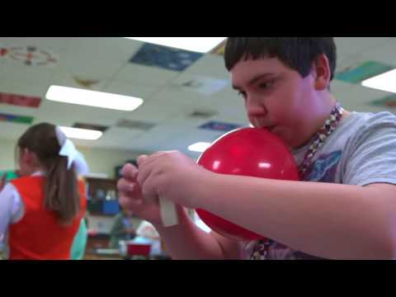
Activity 3: See it in Action
As you watch the video, in the chat…
Note how the teacher uses both active and direct instruction.
How can you tell the students are emotionally and cognitively engaged?
Define what SEL skills the teacher promotes in students.
Notetaking guide page 1
Notes:
00:47-00:56
https://www.youtube.com/watch?v=1qxVfhGHUC0
Let’s what this TN elementary school teacher implement balanced instruction practices. As you watch the video
1. Note how the teacher uses both active and direct instruction. 2. How can you tell the students are emotionally and cognitively engaged 3. Define what SEL skills teacher promotes in students.

Slide 22
Harmony Connections
Notes:
00:57
Let’s dig into how Harmony can support us with Balanced Instruction

Slide 23
Connecting Harmony SEL Skills & Balanced Instruction
Harmony SEL Skills
Deepens social and emotional skills, such as:
managing themselves;
developing, monitoring, and evaluating their goals;
asking for help when needed across tasks;
using relationship skills.
communicating sensibly and sensitively; and
demonstrating empathy in their problem solving and responsible action.
Notetaking guide page 2
Notes:
00:58-01:02
Because social and emotional competencies are integral to the implementation of balanced instruction, educators should ensure that students have multiple and ongoing opportunities to develop and apply these skills in a nurturing, healing, and low-stress environment. For example, students use multiple social and emotional competencies in multidimensional learning experiences, such as:
managing themselves during direct instruction;
developing, monitoring, and evaluating their goals during individual and collective action;
asking for help when needed across tasks;
using relationship skills as they engage in project-based learning—taking the perspective of their peers to successfully complete the project, and making evidence-based decisions to effectively accomplish inquiry-based tasks.
communicating sensibly and sensitively; and
demonstrating empathy in their problem solving and responsible action.
How do you think Harmony supports the SEL skills in students and adults to implement Balanced instruction Practices? See CASEL skills that are used in harmony on notetaking guide page 2.

Slide 24
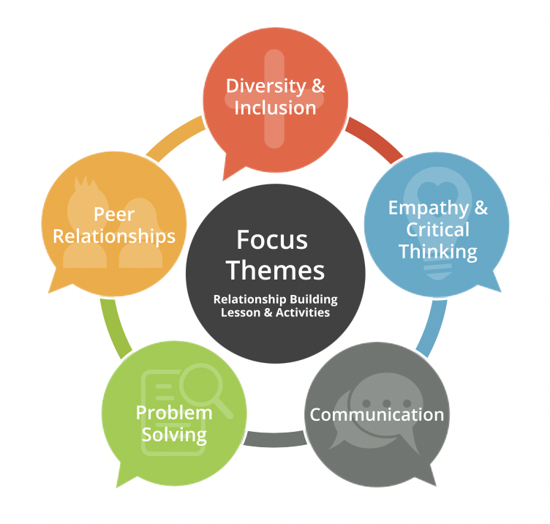
Unit 2: Empathy and Critical Thinking
Develop empathy.
Focus on positive changes in oneself and others.
Reduce stereotyped thinking.
Become aware of how thoughts influence feelings and behaviors.
Develop the tools to change one’s own thoughts.
Interact with one another in more positive ways.
Notes:
01:03
The next Harmony unit we want to look at is Empathy and Critical Thinking
Now more than ever, we realize the importance of understanding others, taking their perspectives and showing that we care.
Why is it is necessary?
Need to deepen relationships
Show greater understanding and care for others
Ensure that others feel valued and cared for
Engage in more positive social interactions
As we move into an activity found within the Unit, I would like for you to think about how you promote empathy and critical thinking in your classroom or school? You can share in the chat if you would like.

Slide 25
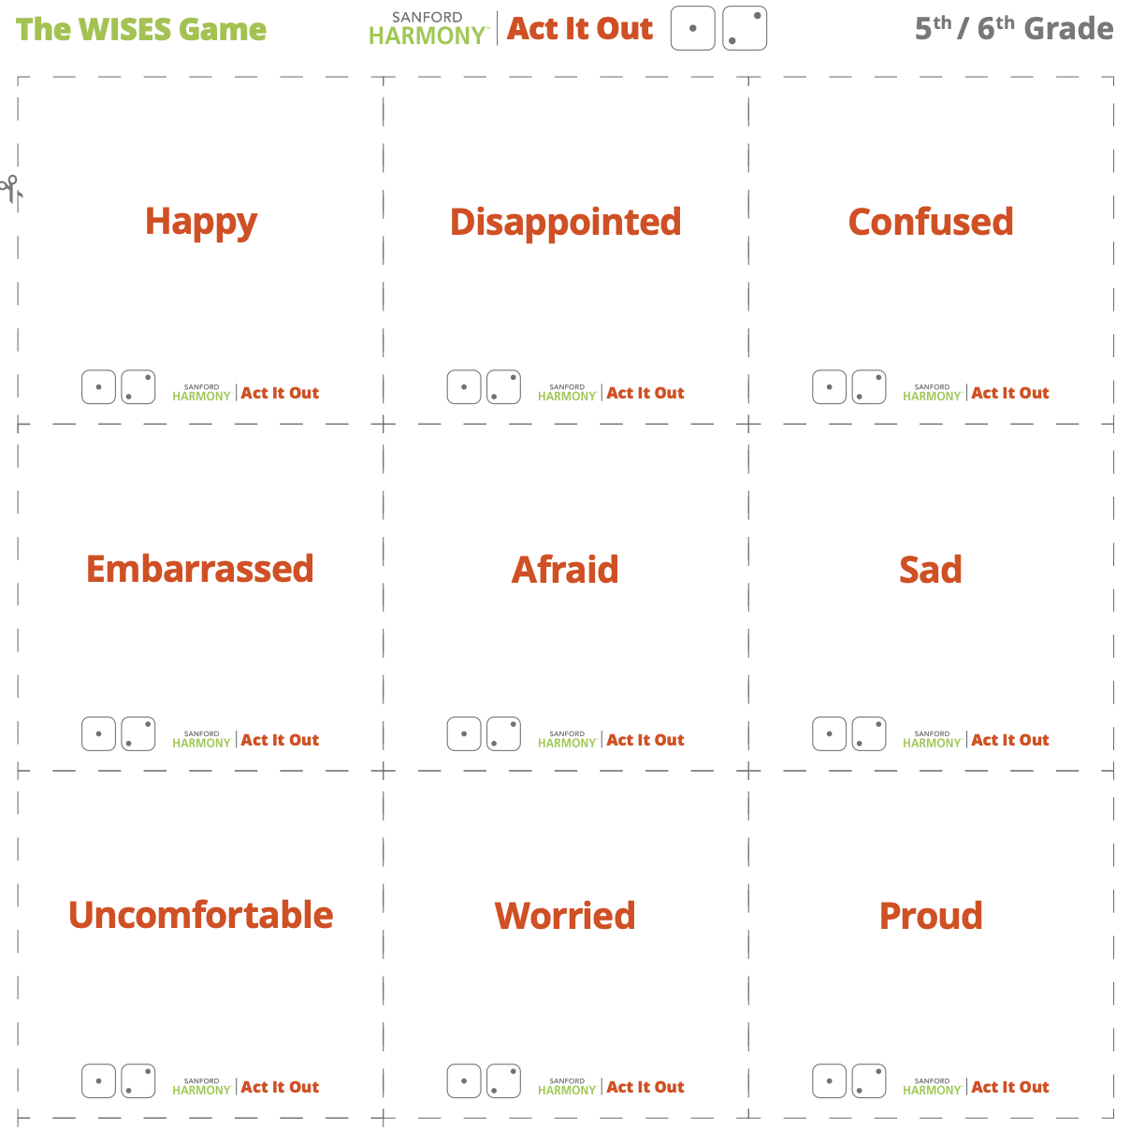
Activity 4: Unit 2, WISES Game
Deepen empathy and perspective taking through a game
Depending on what a student roles, choose a card:
Act It Out
Do You Get Me
Be Cool
Notes:
01:03– 01:10
WISES game –Walking in Someone Else’s Shoes- is used in Unit 2 to promote empathy particularly for those who may be similar to or different.
Students role and dice and chose one of three cards based on their role.
ACT IT OUT cards describe a feeling for you to act out. Kids don’t say the feeling out loud but classmates guess.
DO YOU GET ME cards describe a situation and three options. Students read the card out loud and write response down. Classmates guess what you would have done.
BE COOL cards describe a situation. Each person, including you, writes down a word to describe how they would respond. They share answers with one another. If someone’s answer is the same as yours, keep the card; if not, place the card at the bottom of the deck.
How do you think this game promotes academic learning or how can you use this in the academic learning space?
OPTIONAL ACTIVITY: Go into breakout rooms and have one person select an emotion card. When they select an emotion card, they have to either act it out or explain a situation that may cause this emotion. The other participants in the room, have to guess what emotion the clue giver is feeling. The trick is that just like the game Taboo, you can’t say the emotion!

Slide 26
Activity 5: SEL-Academic Integration Taxonomy
Title: Science Example: Combine Ice, Salt, and Water
SEL Skill: Anticipate and evaluate the consequences of one’s actions.
Content Skill: Analyze data from testing different combinations of materials to determine outcome best suited for intended purpose.
Description:
Let students know that in their daily life, it is often helpful to think about their actions, predict what might happen, and then evaluate those predictions after they act; for example, think of times when they decide to share, meet new friends, or try something new.
Ask students when they have anticipated something and what was the result?
Explain that similarly, scientists use these skills when they make predictions with their experiments.
Encourage students to anticipate or predict what will happen when they combine ice, salt, and water using multiple combinations of the elements and using their knowledge of the properties of each.
After they create their hypotheses, they will have to test their various combinations.
Then they evaluate whether or not their hypotheses worked out.
Have students reflect on skill: Similar to how you behaved as a scientist, anticipating and predicting what will happen when you combine elements, and evaluating those predictions, you can approach other areas of your life in the same way. Have students reflect on other areas in which they use these skills.
Notetaking guide pages 3 & 4
Notes:
01:11 - 01:15
Let’s review a couple of Warm and Support lessons that demonstrate the link between SEL and content skills. Take a minute and review the description.
Poll: We will do a quick poll to determine which taxonomy you think it is. There is no real right answer [do poll].
Answer: Taxonomy: Ways of Being
Ask: Why did you provide your response?
Look at notetaking page 5 to go over the think aloud.
Say: Remember, our goal is to think about intentionality. So when we were creating this lesson, we first wanted to start with the SEL skill, anticipate and evaluate consequences from actions. From there, we thought about what subject really supports this? Recognizing that this is very common in science we decided to choose the science skill about testing a combination of materials, as they are really similar. From there, we realized we could pretty much do any type of hypothesis testing lesson, but the core piece of modification would be helping students transfer the skill from science to other domains, so we needed to add thee part about when they make predictions in their life, and then a reflection on that skill to extend at the end. You may have chosen another taxonomy and that is okay, but our intention here was to really think about the transfer of skills across domains.

Slide 27
Harmony Connection with Balanced Instruction
Activity 6: Reflection
Why is Balanced Instruction important?
How can Harmony SEL skills promote Balanced Instruction?
What can you do differently in your school to support educators and students?
Notetaking guide page 3
Notes:
01:16– 01:18
Take a minute and do an internal reflection on note taking guide page 3
You can also unmute yourselves and share or type in the chat.

Slide 28
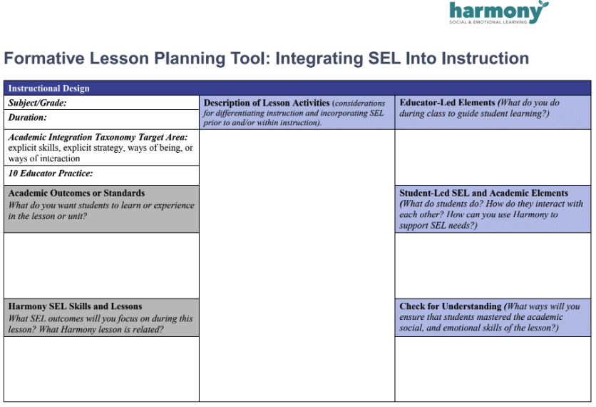
Activity 7: Action Planning
In small groups
Discuss which Harmony SEL skills you might focus on
How could you support those skills within academic instruction
Formative Lesson Guide Document
Notes:
1:19-1:25
Finally, we are going to give you some time to begin action planning with your peers. We are going to put you into small groups and you can use the Formative lesson planning tool to guide your work; and reflect on the two practices. As you work, think about Harmony integrates within this academic instruction.

Slide 29
Wrap Up
Notes:
1:25

Slide 30
Closing
Objective Review
Identified strategies to apply Balanced Instruction practices with SEL
Explored and defined SEL-academic integration taxonomy examples using Harmony SEL skills
Determined how Harmony SEL aligns with integrative practices
Applied lessons learned into your own planning and interactions with students
Notes:
1:27
Remember through this session you…

Slide 32
References
Collaborative for Academic, Social, and Emotional Learning. (2020a). What is SEL? Chicago, IL: Author. Retrieved from https://casel.org/what-is-sel/

Slide 33
SAFE Practices
Sequenced
Active
Focused
Explicit
Source: Durlak et al., 2011
Notes:
00:23
In other words, all SEL efforts should be:
Sequenced, that is, following a specific scope and sequence of when social and emotional competencies will be taught and reinforced, similar to academic content standards;
Active, with students engaging in activities that allow them to practice and apply the targeted social and emotional competencies;
Focused, with instruction concentrating on only one or two social and emotional competencies, sub-competencies, or skills, at a time versus trying to teach or reinforce all social and emotional competencies at once; and
Explicit, with students made aware of, and able to identify, the specific social and emotional competencies, sub-competencies, or skills they are learning and using.

